Slide 1
Mosques in Wolverhampton

Slide 2
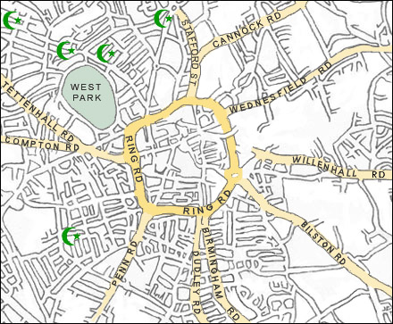
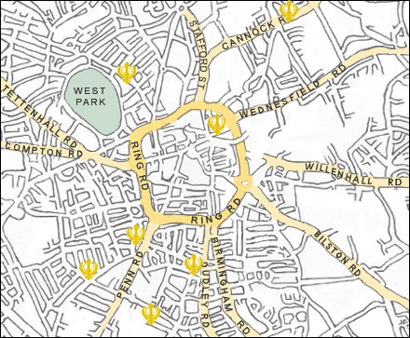
Location of Mosques
Notice the concentration of mosques in the areas that Muslims live in Wolverhampton in the North West areas of the city.

Slide 3
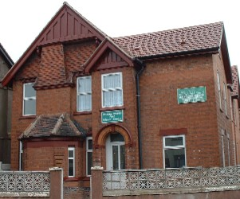
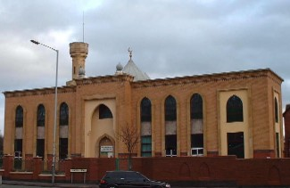
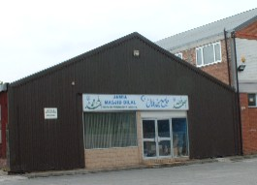
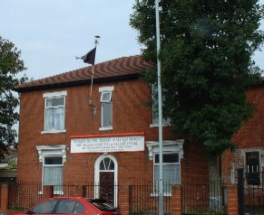
Wolverhampton Central Mosque
Masjid Al Medina
Hussaini I M Ali (AS) Mosque and Shia Muslim Community and Welfare Centre
Jamia Masjid Bilal and Muslim Community Centre
Notes:
Jamia Masjid Bilal and Muslim Community Centre Muslim Educational Trust Masjid Al Medina Wolverhampton Central Mosque Hussaini I M Ali (AS) Mosque and Shia Muslim Community and Welfare Centre

Slide 4
Mosques in Wolverhampton
Which of these building possesses the key features of a mosque? What problems do Muslim communities face in building a purpose built place of worship? What problems are faced in converting houses or warehouses into a mosque? What are the benefits of locating a mosque in a residential area?

Slide 5
Key external features of a mosque
Minaret
Dome

Slide 6
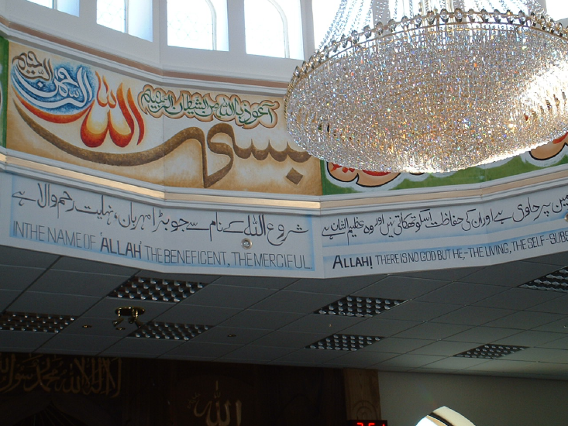
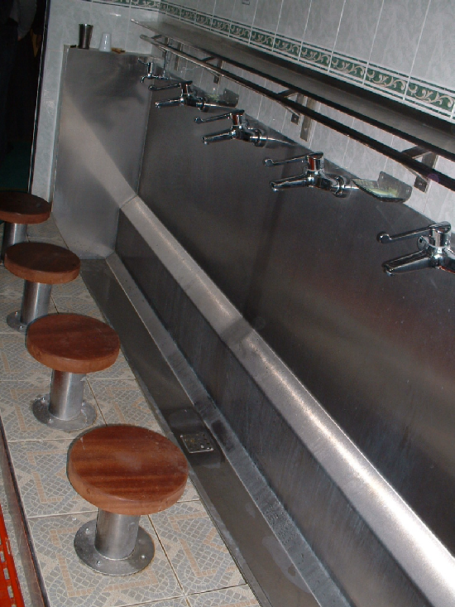
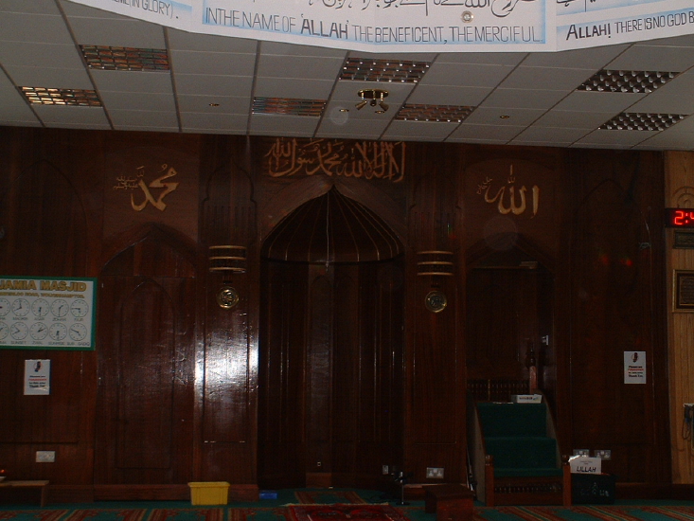
Key internal features
of a mosque
Calligraphy inside the Dome
Prayer times
Ablutions facilities
Mihrab: showing direction of Macca

