Slide 1
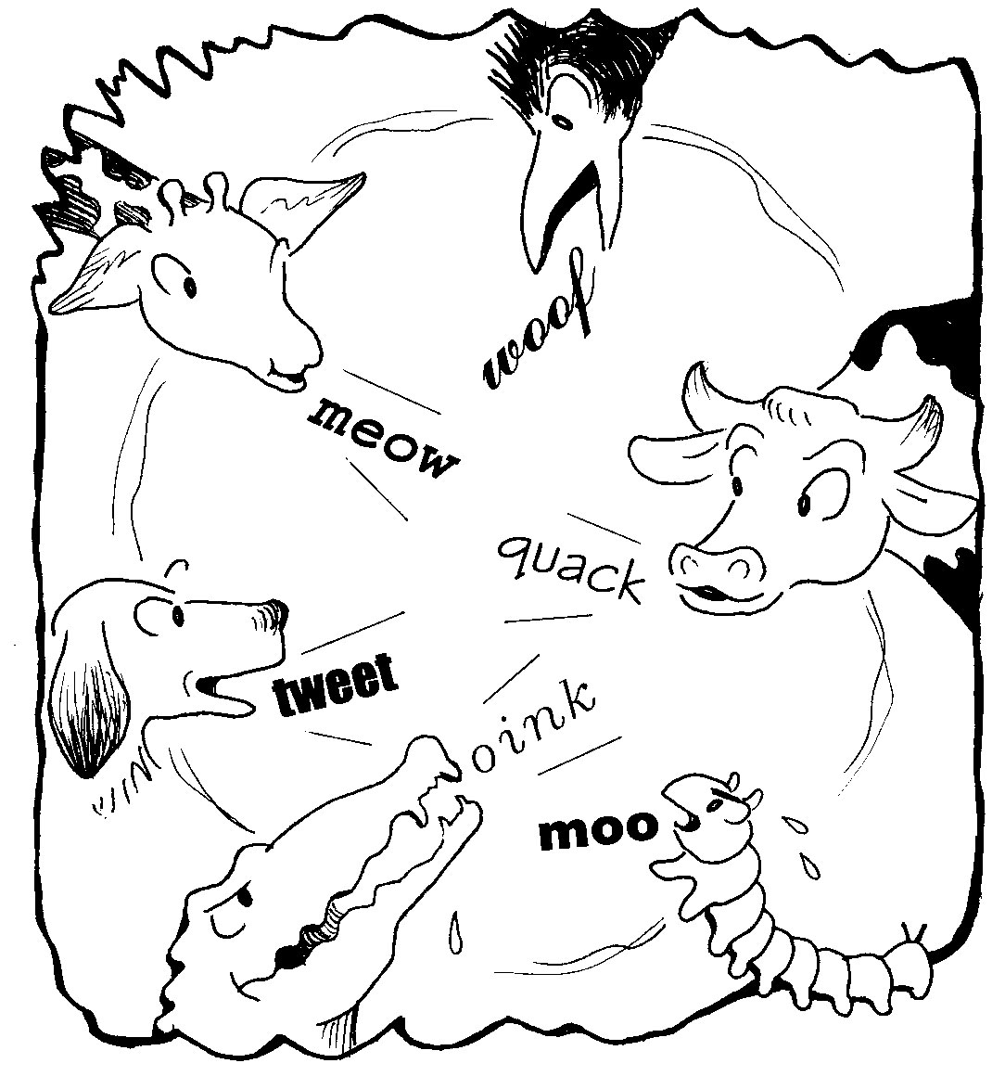
ELL 112 Sounds of English
Lecture 1
Making Sounds

Slide 2
Linguistics
Meaning
Semantics & Pragmatics
Form
Morphology & Syntax
History
Historical Linguistics

Slide 3
The Sounds bit
Phonetics
Phonology

Slide 4
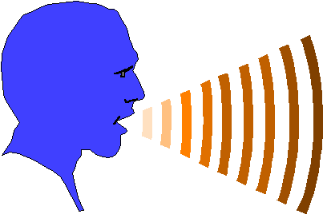
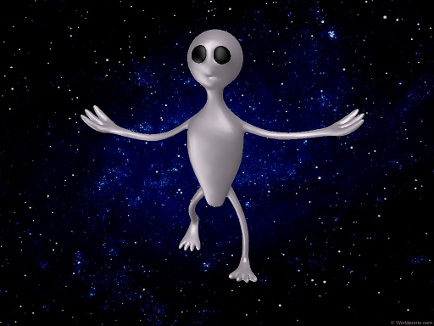
What would an alien see?

Slide 5
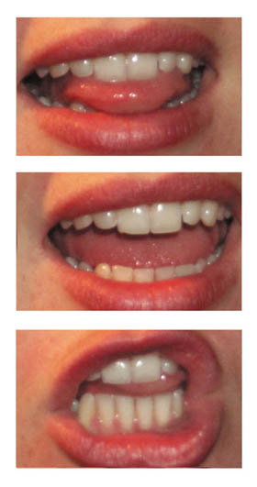
Anatomy
Physiology

Slide 6
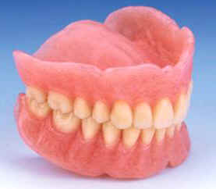
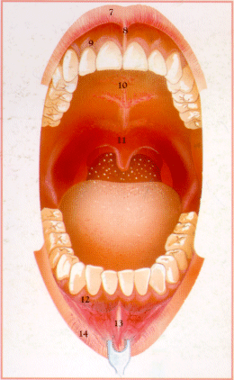
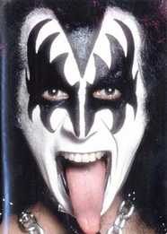
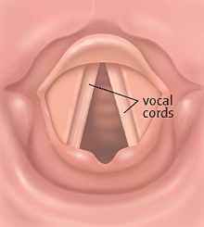
“Parts of speech”

Slide 7
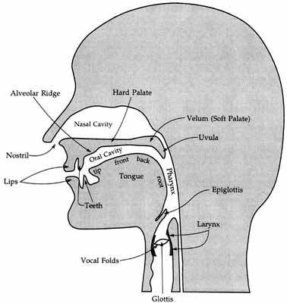
Sagittal section…

Slide 8
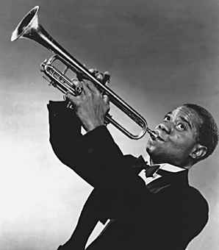
Model of the process
Source
Filter
Initiation
Phonation
Articulation

Slide 9
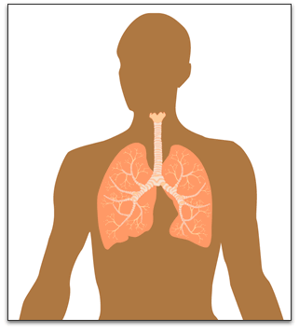
Source / Initiator

Slide 10
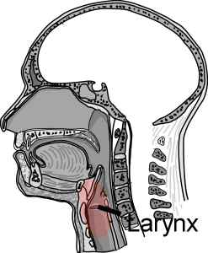
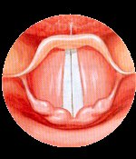
Phonation

Slide 11
Voicing contrasts
Fat Vat
Sit Zit
Thin This

Slide 12
Direction of airstream
Nasal
Lateral
Central oral

Slide 13
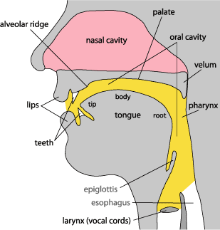
Places of articulation
Bilabial
Labiodental
(Interdental)
Dental
Alveolar
Palatal
Velar

Slide 14
Degree of articulation
Plosive / stop
Trill
Tap / Flap
Fricative
Approximant
[Vowel]

Slide 15
