Slide 1
When research met teaching: publishing, collaborating and students as producers of open educational resources in the OpenLIVES project
Kate Borthwick (Southampton)
Antonio Martínez-Arboleda (Leeds)
University of Southampton and University of Leeds
Languages in Higher Education, Edinburgh, 5/6 July 2012
LLAS
Centre for Languages, Linguistics and Area Studies University of Southampton
Southampton, SO17 1BJ +44 (0) 23 8059 6860 | @LLASCentre | www.llas.ac.uk

Slide 2
Overview
The OpenLIVES project
Publishing research data as open content
Using the data to create OERs
Changing teaching and learning through open practice
Notes:
Comments about how what we are doing through the project could impact on teaching and learning in general.

Slide 3
The OpenLIVES project
Learning Insights from Spanish Emigres (JISC)
Digitisation and open publication of research data
Creation of open educational resources based on the material
Embedding of the material, OERs and open practice in ongoing teaching
Collaboration: Universities of Southampton, Leeds and Portsmouth
Notes:
The Openlives project is funded by the JISC under their digitisation strand – it runs from 2011 – Jan 2013. The LIVES bit stands for ‘Learning insights from Spanish emigres’ and it is a project which seeks to unite research and teaching through open practice. It is a collaboration between three different institutions: Southampton, Leeds and Portsmouth and it is led and managed by the Centre for LLAS. It aims to do three broad things:
Digitise a set of existing research data and publish it openly for others to download and reuse
Create a set of OERs based on the materials, which can also be freely downloaded, used and adapted by others.
Embed the materials, the OERs and open practice into teaching at the three partner institutions.
So it aims to be a project which demonstrates a cycle of open practice: from the collection of research data, to creation of resources, to use, reuse and extension (by others) of OERs in ongoing teaching – and integrating the processes of openness in teaching too.

Slide 4
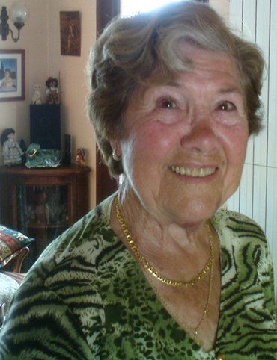
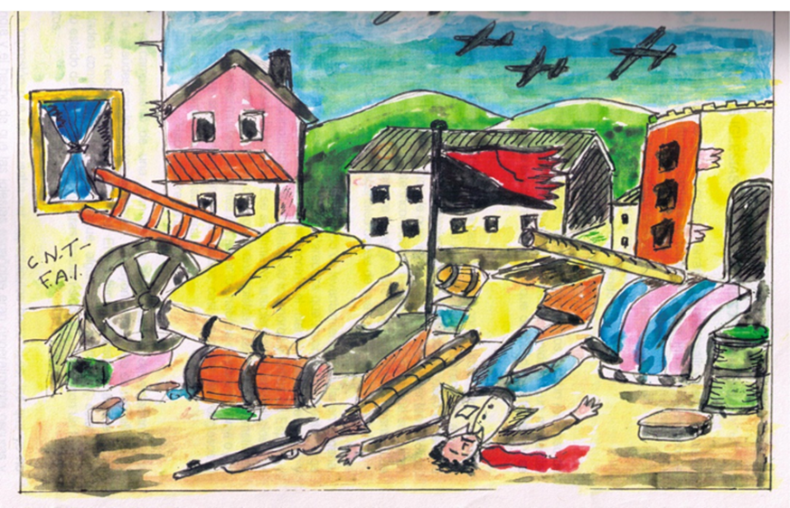
OpenLIVES research data
Wikimedia Commons Creative Commons Attribution-Share Alike 3.0 Unported
Notes:
The research data that will form the core of the project are 23 audio recordings documenting different forms of migration in 20th Century Spain.
Types of migration:
-child evacuations during the Spanish Civil War
-economic and political emigration during the dictatorship of the Franco regime.
-return migration to democratic Spain (When the dictator died in 1975 Spain begins a period of transition to democracy).
The project has a transnational scope: – we have stories that cross many borders at different times: Migration countries : Spain, France, the UK, former Soviet Union, Mexico, Cuba, Venezuela, Argentina and the USA
The interviews were collected as part of a previous research project - Tales of Return: the memories and experiences of Spanish returnee migrants from France and Great Britain (1959-1992) – funded by the University of Southampton in 2008-2009 under its Adventures in Research scheme. Researchers Alicia Pozo-Gutiérrez, Scot Soo and Darren Paffey. Once this project was finished, the material was shelved and forgotten, unavailable to anyone else – and was destined to remain so until the end of 2011, when we got funding to launch the OpenLIVES project.
The core of the material is recordings but it also includes, written memoirs, photographs, press articles, drawings and artefacts.
This range of material has direct applicability to language learning and content-integrated language learning, but it is also of interest to a wide range of disciplines including social science, politics, history, and economics. This raw data will be published openly in our repository called the Humbox, for others to download, adapt and use.

Slide 5
Publishing research data openly
“I was totally seduced by the concept” – Alicia Pozo-Gutierrez, lead researcher in collecting materials
Metadata and context of presentation should “reflect the spirit in which the materials were collected”
Requesting additional licensing permissions should be dealt with sensitively
Notes:
The head researcher who collected the data originally, had few concerns about opening up her data to the world – as you can see from her quotation – she was totally seduced by the concept of her work being used by other students and spreading and expanding in ways she could never have predicted. However she did have some concerns…
Her concerns were focussed around the integrity of the materials and worries about how the data may be used, or misused, after all these are personal testimonies – she felt it would be important to make sure that metadata and the context of presentation reflected “the spirit in which the materials were collected,” and the team have carefully considered how this material should be presented online and with which creative commons licenses and other descriptive information. She also noted that this particular group of interviewees had experienced extreme cultural oppression, and had a mistrust of officialdom – this meant that the issue of requesting additional permissions for open sharing was one which required great sensitivity. When the material had originally been collected, making it open access had not been envisaged – and this is something, that with increased openness, researchers should consider.

Slide 6
Notes:
This is an example of an OpenLIVES resource made available through the HumBox: you can see –
Group
Files
Description
This material is openly licensed for others to adapt and use.
This is the material…now over to Antonio, who will tell you about the exciting teaching and resource creation that is going on using the materials.

Slide 7
Some Pedagogical Applications
Miguel Arrebola (Portsmouth) - Irina Nelson (Southampton)
- Antonio Martínez-Arboleda (Leeds)
Open Educational Resources – OERs Methodology for Oral Histories Interviews
OER Subtitling Project
OER Magazine
OER Language Materials for Beginners
Open Lives Module: Discovering Spanish Voices Abroad in a Digital World
Contextualising and introducing an oral history interview: OpenLIVES Autonomous Learning Activity

Slide 8
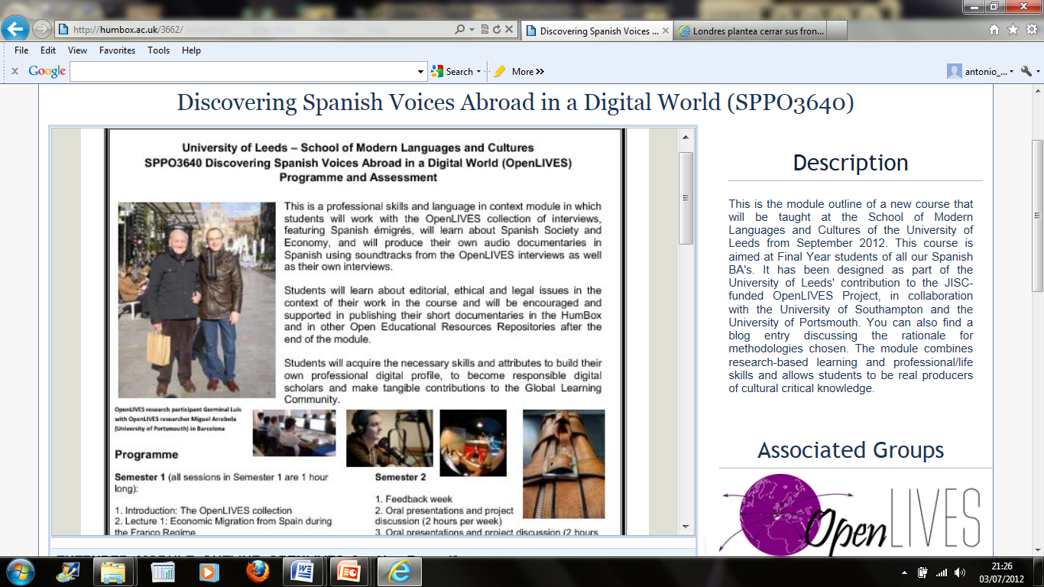
OpenLIVES module @ Leeds

Slide 9
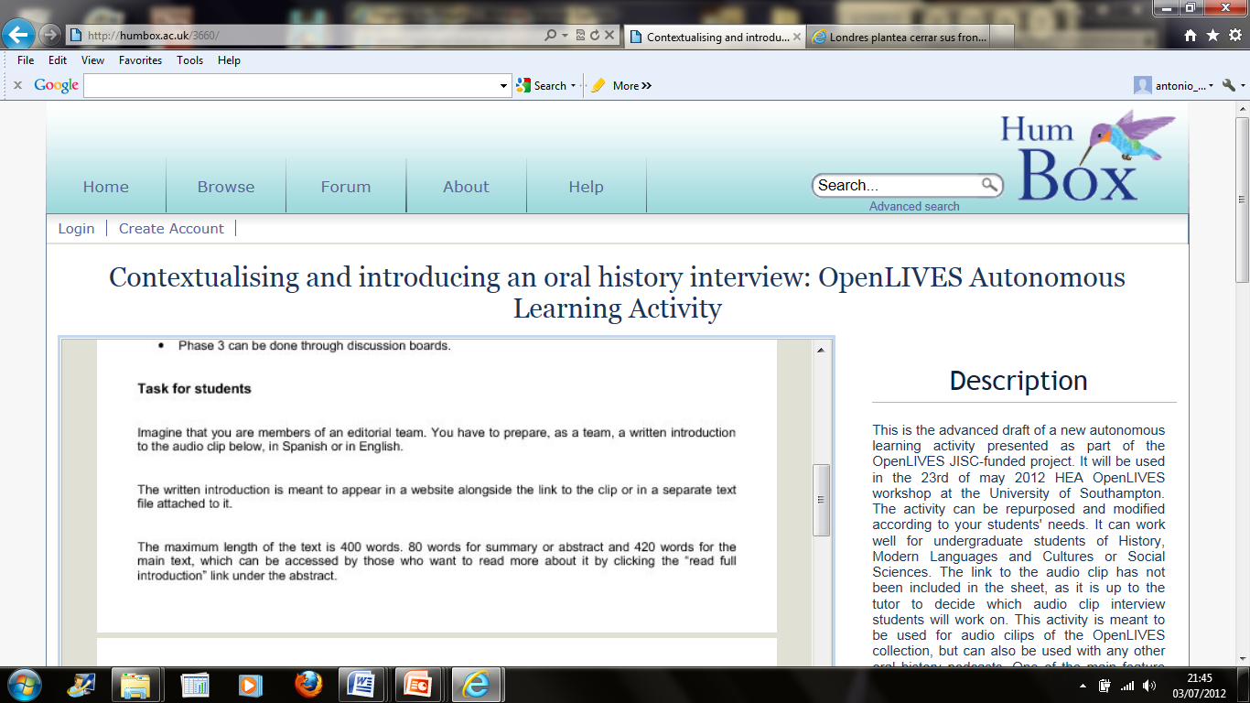
OpenLIVES Autonomous Learning

Slide 10
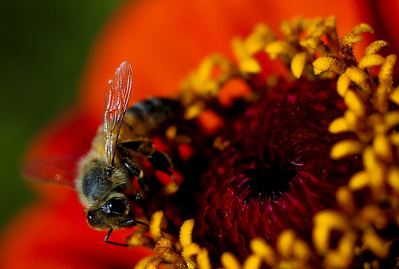
OpenLIVES Organic Pedagogy
Social,
Meaningful,
Integral,
Trans-academic,
Collaborative,
Ethical,
and Personalised Learning
-Chris Willis , Flickr CC BY

Slide 11
OpenLIVES Organic Pedagogy
Socially and personally relevant student outputs: Digital profile, socially and personally meaningful, engaging. From pupil student to researcher, producer (Mike Neary) and public author.
2. Full-cycle complex student production process
From the fields to the table
3. Trans-academic life skills
Academic Skills transferred to professional/life contexts within an educational environment – transferring skills
‘Transferring skills’: higher order skills that enable the person ‘to select, adapt, adjust and apply [his or her] other skills to different situations, across different social contexts and perhaps similarly across different cognitive domains’ (Bridges, 1993, p.50).

Slide 12
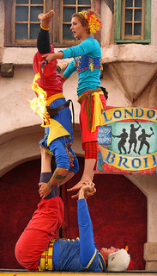
OpenLIVES Organic Pedagogy
4. Socially constructed knowledge
5. Research-based graded learning
M. Healey + RSD of the University of Adelaide
7 Ethically produced knowledge
8. Flexible and personalised learning
Alaska_Dude, Flickr, CC BY

Slide 13
How can I get involved?
Join the community repository HumBox: www.humbox.ac.uk
Create a profile
Browse the site and look at the OpenLIVES resources
Share your own work
Set up a group and appeal for others with similar interests to join and share their work; set up a group for your own institution or team
If you have material related to the topics and themes explored in OpenLIVES, join our group and share your materials

Slide 14
Useful links for info and advice
Read about the project:
Blog: http://openlives.wordpress.com/
Visit our group on HumBox: http://humbox.ac.uk/group/2
Tweet: #openlives @KBorthwick @Toni_M_Arboleda @LLASCentre
More about open practice:
OER Infokit: http://bit.ly/oerinfokit
The JISC (funding, OER projects): www.jisc.ac.uk
Open Courseware Consortium: www.ocwconsortium.org

Slide 15
External references of work mentioned today
Student as Producer: http://studentasproducer.lincoln.ac.uk/ (Mike Neary) (last accessed 5 July 2012)
Jenkins A, Healey M and Zetter R, Linking teaching and research in departments and disciplines York: The Higher Education Academy 2007 http://www.heacademy.ac.uk/assets/documents/teachingandresearch/LinkingTeachingAndResearch_April07.pdf (last accessed 5 July 2012)
Yorke, M. Employability in higher education: what it is – what it is not The Higher Education Academy Learning and Employability Series. 2006. http://www.heacademy.ac.uk/assets/documents/employability/id116_employability_in_higher_education_336.pdf (last accessed 5 July 2012)
Ehiyazaryan, E. & Barraclough, N. (2009). Integrating real world experience in the curriculum: enhancing learners' employability. Education & Training Journal, 51(4), pp. 292-308.
http://www.adelaide.edu.au/rsd/framework/ (last accessed 5 July 2012)

